Slide 1



Bilgisayar Mühendisliği Bölümü
GTU CSE 414
INTRODUCTION TO DATABASE PROJECT
DATABASE FOR A HYPOTHETICAL COMPANY
ÇAĞRI ÇAYCI
JUNE 2024
GTÜ - Bilgisayar Mühendisliği Bölümü
BİL 495/496 Bitirme Projesi
Notes:
1.7.2013
1
‹#›

Slide 2
Contents
  ER Diagram
  Functional Dependencies
  Normalization
  Database Schema
  User Interface
  Triggers
  Views
  Transactions
  Privileges and Roles
GTU COMPUTER ENGINEERING DEPARTMENT
INTRODUCTION TO DATABASE
Notes:
1.7.2013
2
‹#›

Slide 3
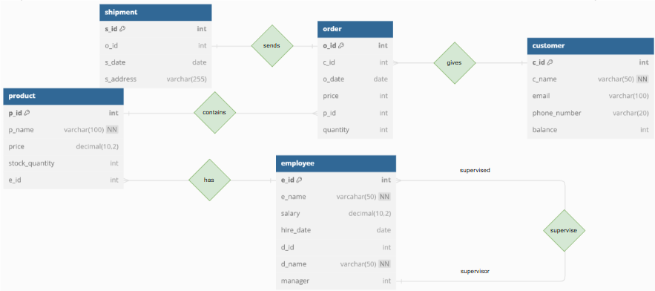
ENTITY-RELATIONSHIP DIAGRAM
The E-R Diagram of the Database;
GTU COMPUTER ENGINEERING DEPARTMENT
INTRODUCTION TO DATABASE
Notes:
1.7.2013
2
‹#›

Slide 4
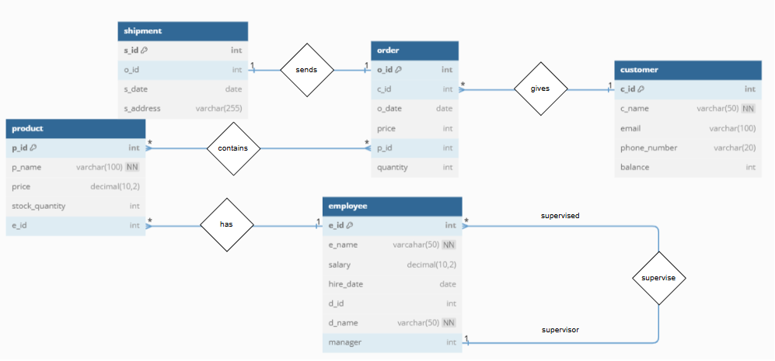
FUNCTIONAL DEPENDENCIES
Employee Table
e_id ->
e_name,
salary,
hire_date,
d_id
d_id ->
d_name,
manager
GTU COMPUTER ENGINEERING DEPARTMENT
INTRODUCTION TO DATABASE
Notes:
1.7.2013
2
‹#›

Slide 5
FUNCTIONAL DEPENDENCIES
Order Table
o_id ->
c_id,
o_date,
p_id,
{o_id, p_id} ->
quantity
{p_id, quantity} ->
price
GTU COMPUTER ENGINEERING DEPARTMENT
INTRODUCTION TO DATABASE
Notes:
1.7.2013
2
‹#›

Slide 6
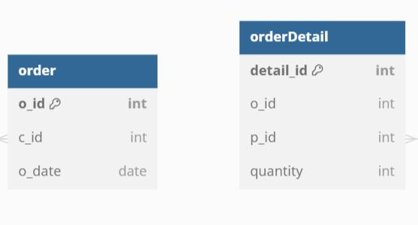
NORMALIZATION
The table order is split into two because it violates the condition of the Third Normal Form (3NF) due to a transitive dependency. By splitting the table, the transitive dependency between o_id and price is eliminated.
GTU COMPUTER ENGINEERING DEPARTMENT
INTRODUCTION TO DATABASE
Notes:
1.7.2013
2
‹#›

Slide 7
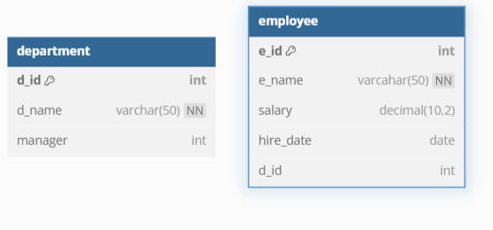
NORMALIZATION
The table employee is splitted into two because it also violates 3NF due to transitive dependency. In this way, the transitive dependency between e_id and manager is avoided.
GTU COMPUTER ENGINEERING DEPARTMENT
INTRODUCTION TO DATABASE
Notes:
1.7.2013
2
‹#›

Slide 8
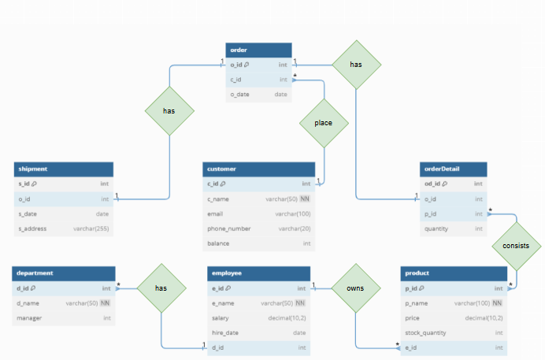
NORMALIZATION
After normalization, the ER diagram of the database appears as follows:
GTU COMPUTER ENGINEERING DEPARTMENT
INTRODUCTION TO DATABASE
Notes:
1.7.2013
2
‹#›

Slide 9
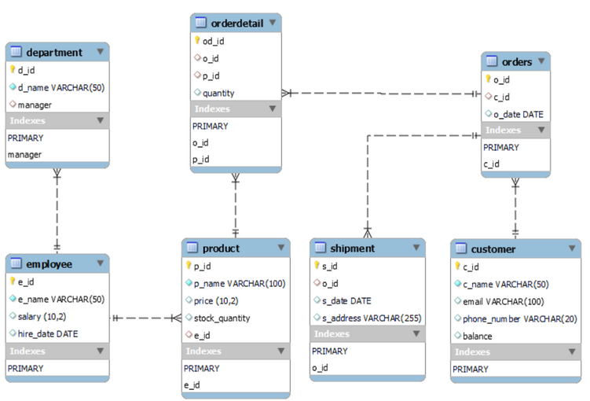
DATABASE SCHEMA
After normalization, the database schema has been designed.
GTU COMPUTER ENGINEERING DEPARTMENT
INTRODUCTION TO DATABASE
Notes:
1.7.2013
2
‹#›

Slide 10
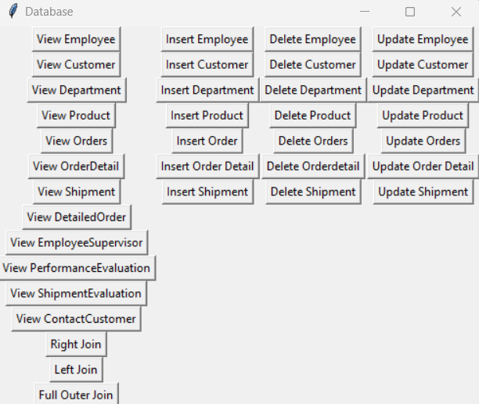
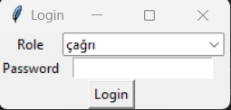
USER INTERFACE
The user interface has been developed.
GTU COMPUTER ENGINEERING DEPARTMENT
INTRODUCTION TO DATABASE
Notes:
1.7.2013
2
‹#›

Slide 11
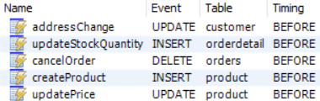
TRIGGERS
  addressChange: Changes the adress of the shipment when customer adress is changed.
  updateStockQuantity: Updates the stock quantity of a product when it is added to orderDetail table.
  cancelOrder: Refunds the money of the order to customer.
  createProduct: Raises the salary of employee when it creates a product.
  updatePrice: Updates the price of the product according to stock quantity.
GTU COMPUTER ENGINEERING DEPARTMENT
INTRODUCTION TO DATABASE
Notes:
1.7.2013
2
‹#›

Slide 12

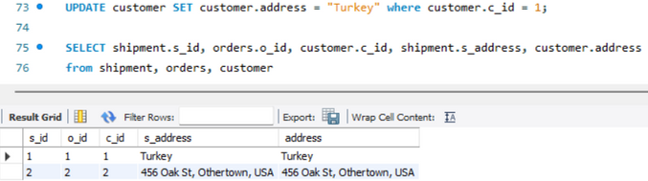

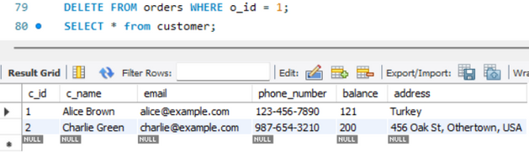
TRIGGERS
  addressChange
  cancelOrder
GTU COMPUTER ENGINEERING DEPARTMENT
INTRODUCTION TO DATABASE
Notes:
1.7.2013
2
‹#›

Slide 13

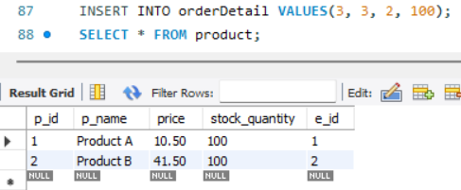
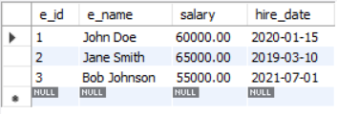
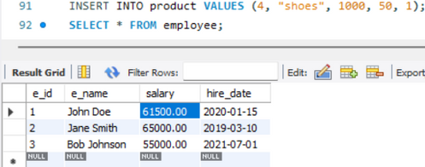
TRIGGERS
  updatePrice
  createProduct
GTU COMPUTER ENGINEERING DEPARTMENT
INTRODUCTION TO DATABASE
Notes:
1.7.2013
2
‹#›

Slide 14
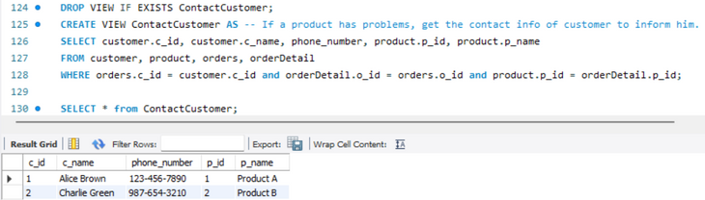
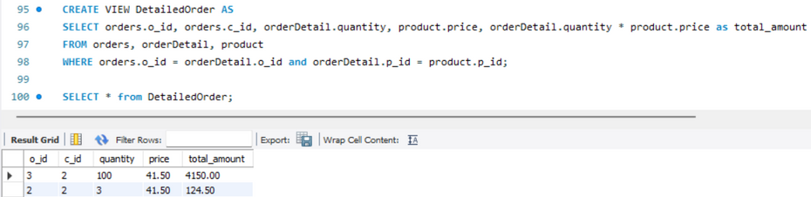
VIEWS
  contactCustomer: If a product has problems, gets the contact info of customer to inform him.
  detailedOrder: Gets the total price of an order.
GTU COMPUTER ENGINEERING DEPARTMENT
INTRODUCTION TO DATABASE
Notes:
1.7.2013
2
‹#›

Slide 15
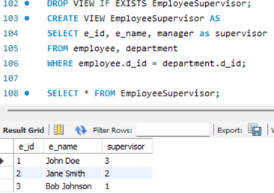
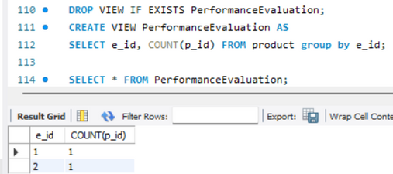
VIEWS
  employeeSupervisor: Gets the name of the employee’s supervisor to complain about him.
  performanceEvaluation: Evaluates employees in terms of their number of products.
GTU COMPUTER ENGINEERING DEPARTMENT
INTRODUCTION TO DATABASE
Notes:
1.7.2013
2
‹#›

Slide 16
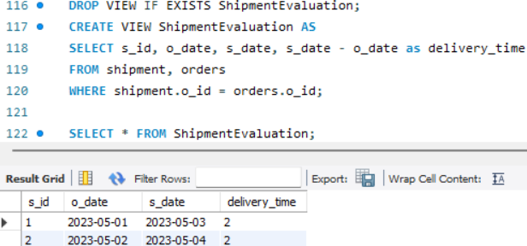
VIEWS
  shipmentEvaluation: Evaluate shipment in terms of delivery date.
GTU COMPUTER ENGINEERING DEPARTMENT
INTRODUCTION TO DATABASE
Notes:
1.7.2013
2
‹#›

Slide 17
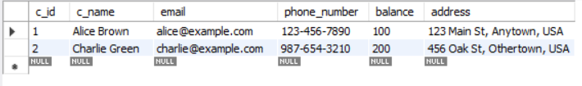
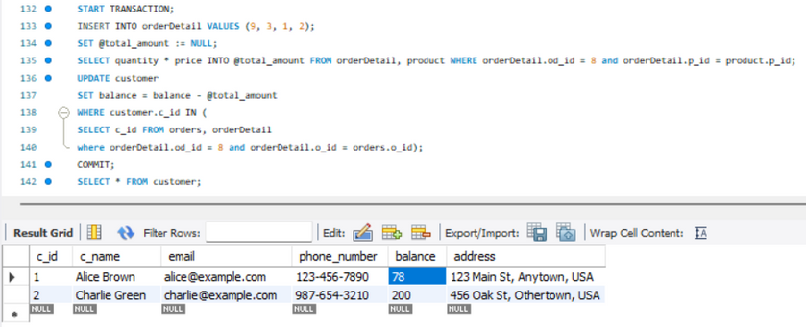
TRANSACTIONS
  Updating balance after order placed.
GTU COMPUTER ENGINEERING DEPARTMENT
INTRODUCTION TO DATABASE
Notes:
1.7.2013
2
‹#›

Slide 18
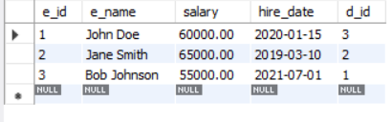
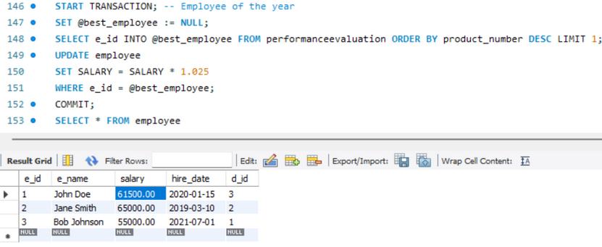
TRANSACTIONS
  Selecting the employee of the year and awarding them a raise.
GTU COMPUTER ENGINEERING DEPARTMENT
INTRODUCTION TO DATABASE
Notes:
1.7.2013
2
‹#›

Slide 19
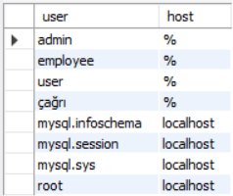

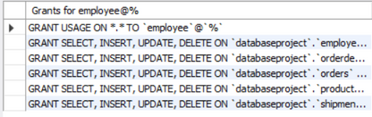
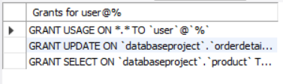
PRIVILIGES AND ROLES
  çağrı: The administrator of the database so, this role has all the privileges.
  employee: Similar to the role of an administrator, but without the ability to list customers or link customers with products, ensuring customer privacy is maintained.
  user: User can only list the products and update order details.
GTU COMPUTER ENGINEERING DEPARTMENT
INTRODUCTION TO DATABASE
Notes:
1.7.2013
2
‹#›

Slide 20
THANK YOU FOR LISTENING
GTU COMPUTER ENGINEERING DEPARTMENT
CSE 495 GRADUATION PROJECT

